Slide 1
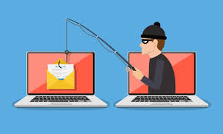
Title: Phishing Awareness Training Subtitle: How to Recognize and Avoid Phishing Attacks
Presented by: Laiba

Slide 2
Objective: -Educate others about phishing attacks. -Equip others with the knowledge to recognize and avoid phishing attempts.
Agenda:
Definition of phishing
Types of phishing attacks
Recognizing phishing attempts
Strategies to avoid phishing

Slide 3
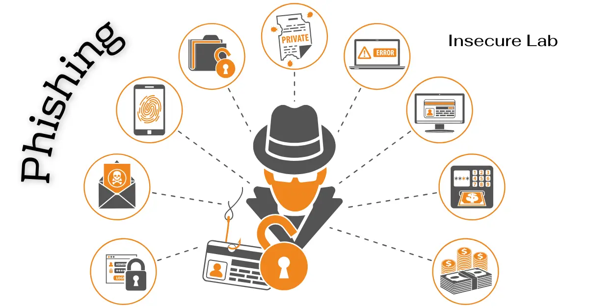

Slide 4
What is Phishing?
Definition:
Phishing is a cyber attack where attackers impersonate legitimate entities to steal sensitive information such as usernames, passwords, and financial information.
Purpose:
To gain unauthorized access to systems.
To steal money or gather personal information for malicious purposes.

Slide 5
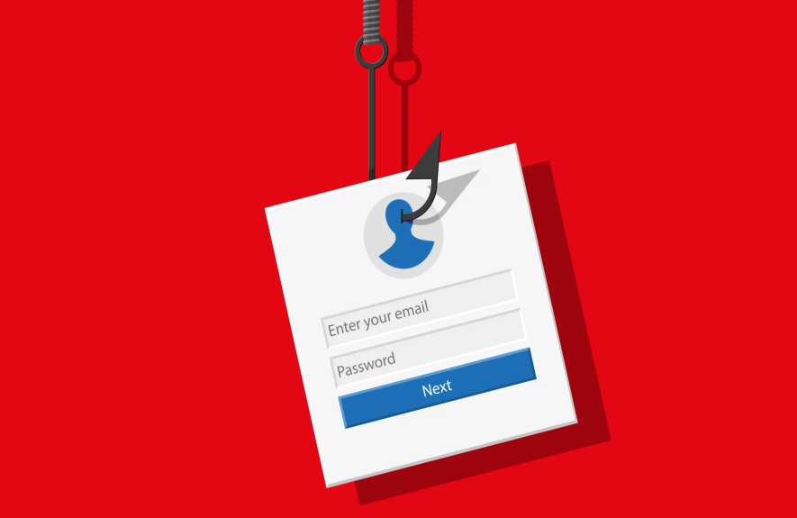
Types of Phishing Attacks
Email Phishing:
Fraudulent emails that appear to come from reputable sources.
Example: An email that looks like it’s from a bank asking you to verify your account.

Slide 6
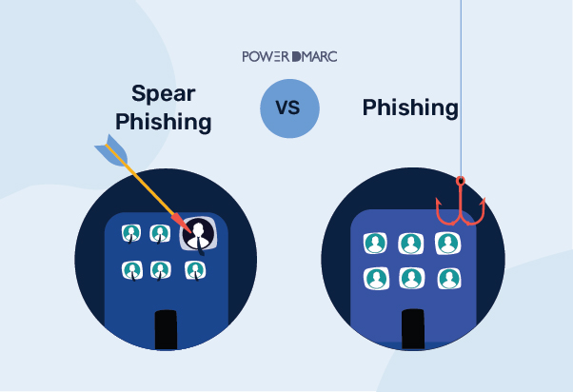
Spear Phishing:
Targeted phishing aimed at specific individuals or organizations.
Example: A personalized email to a company executive with specific details about the organization.

Slide 7

Whaling:
Phishing attacks targeting high-profile individuals like executives or senior management.
Example: An email to a CEO appearing to be from a trusted partner.

Slide 8

Vishing:
Voice phishing conducted over the phone.
Example: A phone call claiming to be from your bank asking for your account details.

Slide 9
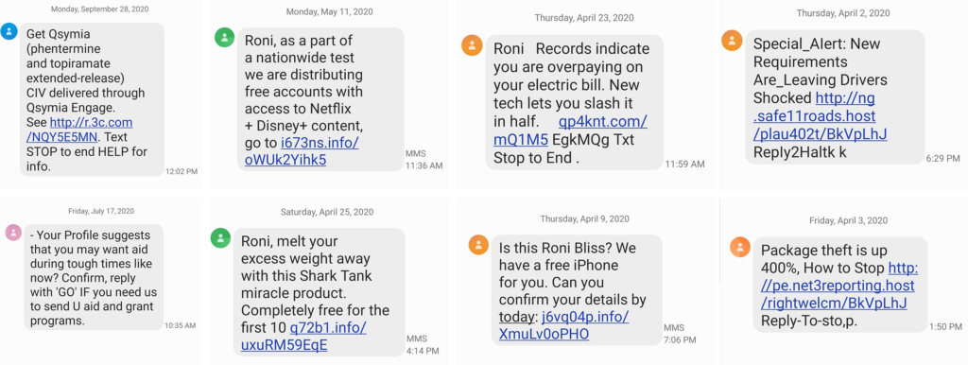
Smishing:
Phishing through SMS text messages.
Example: A text message claiming you’ve won a prize and asking for personal information

Slide 10
Recognizing Phishing Emails
Red Flags:
Unusual Sender Address: Check the sender’s email address for inconsistencies.
Generic Greetings: Phrases like “Dear Customer” instead of your name.
Urgent or Threatening Language: Phrases like “Immediate action required.”
Suspicious Attachments or Links: Hover over links to check the URL; be wary of unexpected attachments.
Poor Grammar and Spelling: Many phishing emails contain grammatical errors and typos.
Examples:
Show screenshots of actual phishing emails with highlighted red flags.
Explain why these elements are suspicious.

Slide 11
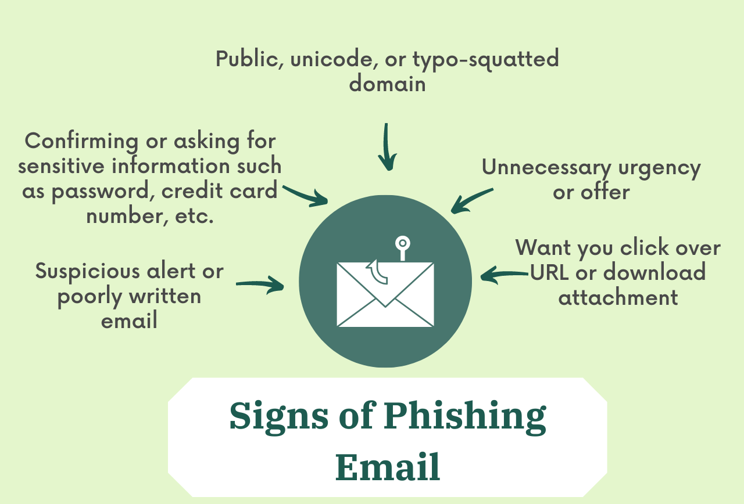

Slide 12
Recognizing Social Engineering Tactics
Techniques:
Impersonation: Pretending to be someone trustworthy or authoritative.
Pretexting: Creating a fabricated scenario to obtain information.
Baiting: Enticing targets with something appealing to get information.
Tailgating: Following someone into a restricted area without authorization.
Examples:
Share stories or case studies of social engineering attempts.
Discuss how these tactics manipulate human psychology.

Slide 13
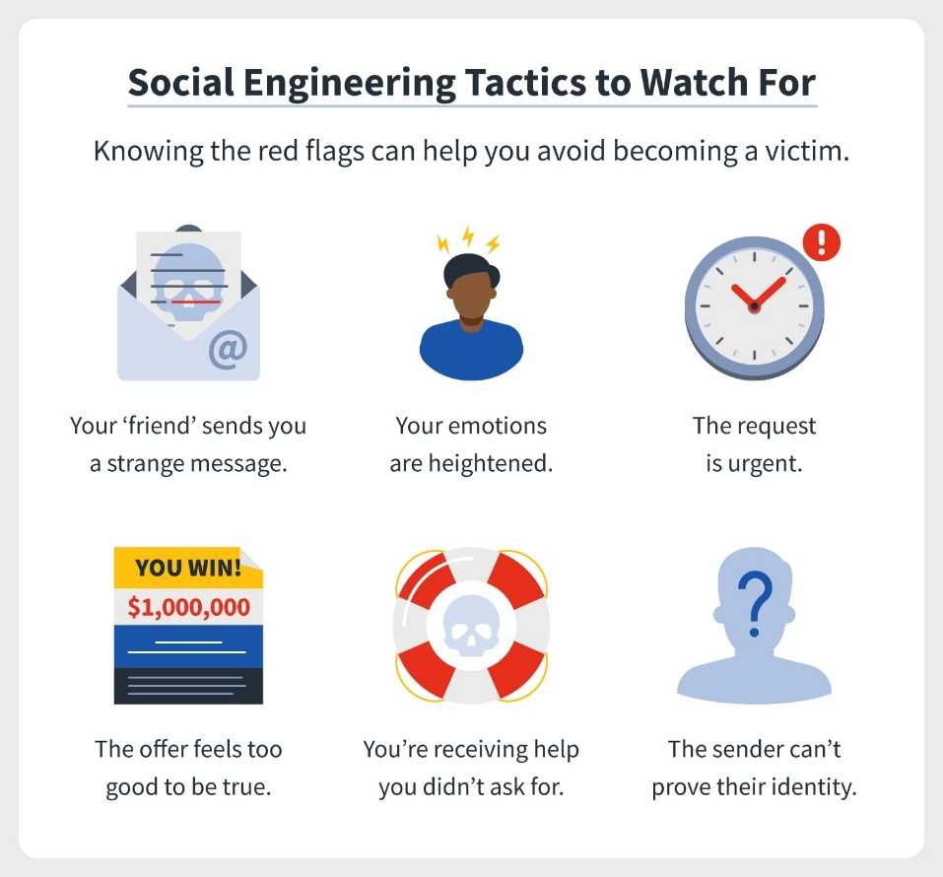

Slide 14
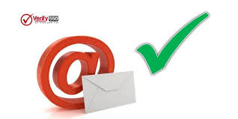
Strategies to Avoid Phishing
Verify the Sender:
Always check the sender’s email address for inconsistencies.
Be cautious of emails from unfamiliar sources.

Slide 15
Hover Over Links:
Always hover over links to see the actual URL before clicking.
Be Skeptical:
Question unexpected requests for sensitive information.
When in doubt, contact the supposed sender directly through a known channel.

Slide 16
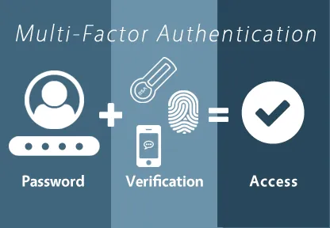
Use Multi-Factor Authentication (MFA):
Adds an extra layer of security to your accounts.
Even if your password is compromised, MFA can prevent unauthorized access.

Slide 17
Keep Software Updated:
Ensure your security software and operating systems are up to date.
Updates often include patches for security vulnerabilities.
Report Suspicious Activity:
Know the internal procedures for reporting phishing attempts.
Prompt reporting can help protect the entire organization.

Slide 18
Conclusion Phishing attacks can be devastating, but by being aware of the tactics used by scammers, you can protect yourself from these types of attacks. Remember to always verify the authenticity of emails and websites, use strong passwords, and keep your software up to date.

Slide 19
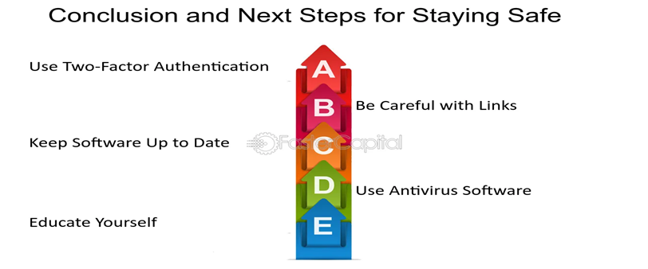
Stay safe online!

Slide 20
Thank You

